Slide 1
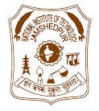
CS4135 Image Processing
A Novel Approach toward detection of Glaucoma using Machine Learning Techniques
SWAPNIL RAJ (2024PGCSDS01)
DEVAKRISHNA T P (2024PGCSDS09)
Under the guidance of
Dr K K SINGH
(Department of CSE, NIT Jamshedpur)
Computer Science and Engineering
National Institute of Technology Jamshedpur
Date of Presentation: 17/12/2024
MVI LAB

Slide 2
INTRODUCTION
Glaucoma is a group of progressive eye diseases that damage the optic nerve, often due to increased pressure in the eye (intraocular pressure).
Early detection is critical to prevent blindness.
Computer-assisted diagnostic tools and CNNs are increasingly used for accurate and reliable detection.

Slide 3
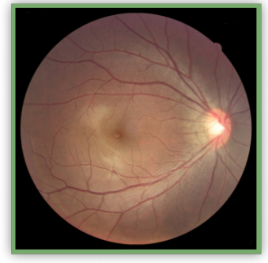
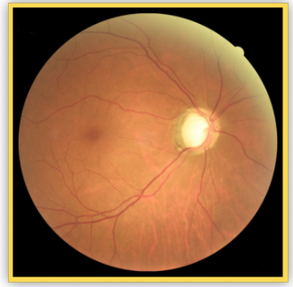
OVERVIEW
RNFL Thickness: Measured as the thickness of nerve fibers surrounding the optic disc.
Thinner RNFL indicates Glaucoma
Eye Image Not Affected by Glaucoma
Eye image Affected by Glaucoma

Slide 4
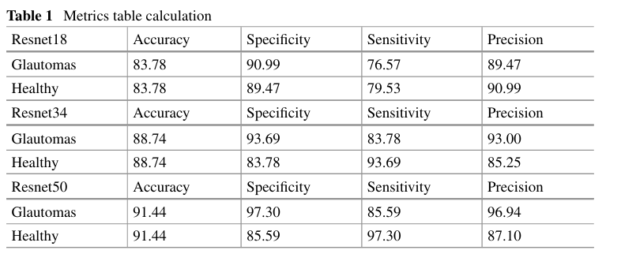
LITERATURE REVIEW
A Novel Approach Toward Detection of Glaucoma Using Machine Learning Techniques-Addepalli Venkatanand ram and Benjoshuva Methari

Slide 5
DATASET
Source: https://www.kaggle.com/datasets/deathtrooper/glaucoma-dataset-eyepacs-airogs-light-v2
8000 Images for training
Classes:
NRG (Non-Referable Glaucoma).
RG (Referable Glaucoma).
Preprocessing:
Resized to 224x224.
Augmentation: Horizontal flips, rotations, and normalization.

Slide 6
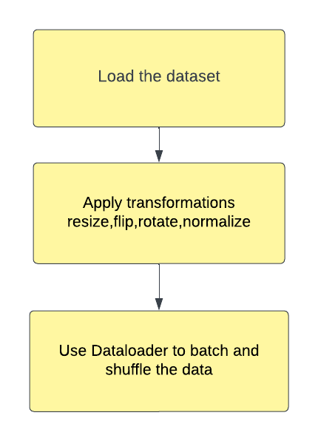
DATA PREPROCESSING
Load the dataset
Preprocess images to match Resnet-34
Transformations applied-resize,flip,rotate,normalize
Split data into training,validation and testing
Use dataloader for batching and shuffling

Slide 7
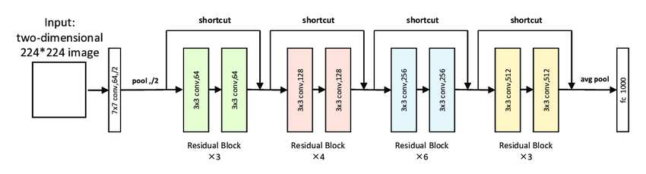
MODELS USED
Models
ResNet34:
Pre-trained on ImageNet.
Fully connected layer modified for binary classification.
ResNet50:
Similar setup with deeper architecture.
RESNET-34

Slide 8
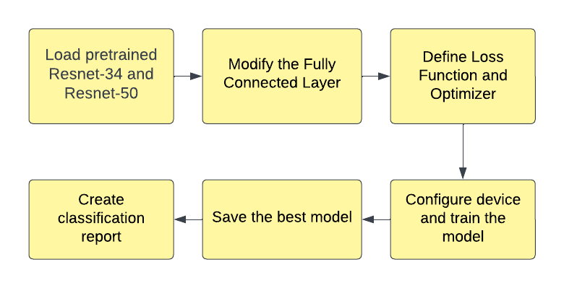
MODEL DEVELOPMENT

Slide 9
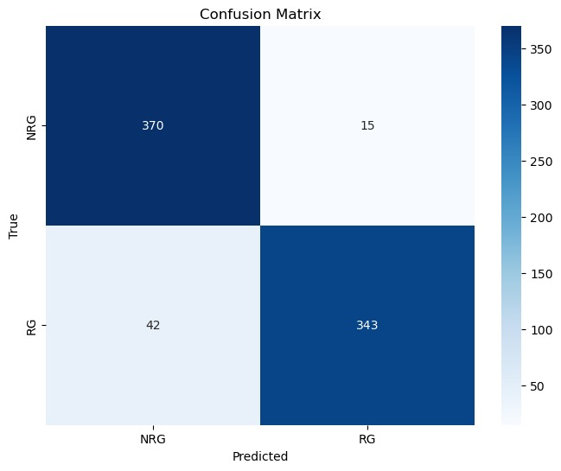
Confusion Matrix – RESNET34

Slide 10
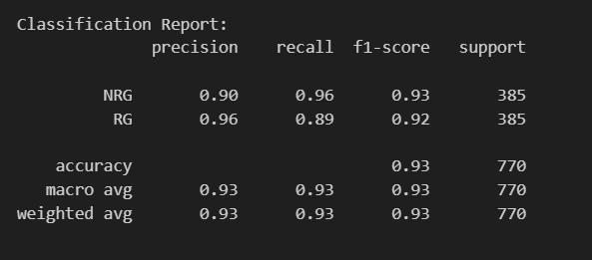
RESULTS-RESNET34

Slide 11
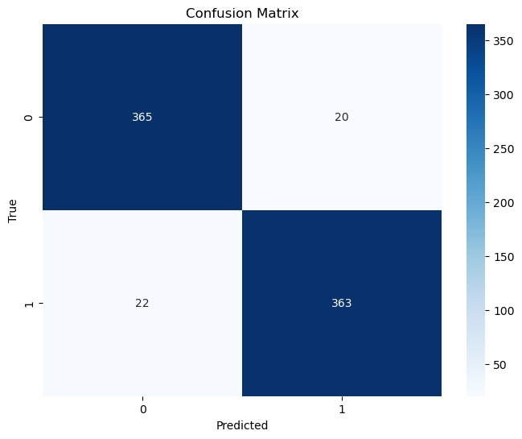
Confusion Matrix –RESNET50

Slide 12
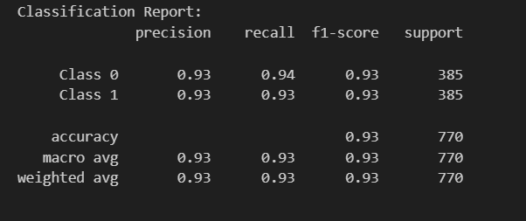
RESULTS-RESNET50

Slide 13
CONCLUSION
This study demonstrates the effectiveness of deep learning models in glaucoma detection using fundus images
By evaluating ResNet34, and ResNet50 architectures, it was observed that ResNet50 achieved slightly superior performance in terms of accuracy, sensitivity, specificity, and precision.
Future enhancements, such as incorporating larger datasets and more advanced models, can further improve accuracy and reliability, enabling early detection and reducing the burden of vision loss due to glaucoma

Slide 14
REFERENCES
Gheisari S, Shariflou S, Phu J et al (2021) A combined convolutional and recurrent neural network for enhanced glaucoma detection. Sci Rep 11:1945. https://doi.org/10.1038/s41598 021-81554-4
Christopher M, Nakahara K, Bowd C, Proudfoot JA, Belghith A, Goldbaum MH, Rezapour J, Weinreb RN, Fazio MA, Girkin CA, Liebmann JM, De Moraes G, Murata H, Tokumo K, Shibata N, Fujino Y, Matsuura M, Kiuchi Y, Tanito M, Asaoka R, Zangwill LM. Effects of study population, labeling and training on glaucoma detection using deep learning algorithms. Transl Vis Sci Technol 9(2):27
Howard J, Gugger S (2020) fastai: a layered API for deep learning, computer vision and pattern recognition (cs.CV); neural and evolutionary computing (cs.NE); machine learning (stat.ML), arXiv:2002.04688

Slide 15
THANK YOU

